Slide 1
Live DotProduct Webinar January 27, 2021

Slide 2
Today’s Presenters
Chris Ahern
Marketing, Sales & Product Manager
DotProduct LLC
Boston, MA
Rafael Spring
CTO & Co-Founder
DotProduct LLC
Wiesbaden, Germany
DotProduct specializes in high performance, easy-to-use solutions for capturing and processing 3D data. Their flagship Dot3D software powers a full suite of handheld 3D capture solutions across the latest tablet, phone, and 3D sensing platforms.

Slide 3
Our Handheld 3D Scanning Solutions
DotProduct Handheld 3D Scanning
✓ Truly Mobile | Walk around objects of interest
✓ Simple to Use | Field workers can use the tech
✓ Handheld | No tripod needed
✓ Inexpensive | $1K-$6K all-in starting costs
✓ Accurate | Engineering grade data
✓ Real-Time | Know what you have in the field

Slide 4
4 components of Dot3D scanning
Tablet / phone hardware (NEW! Note20, S21…)
Depth sensing cameras (NEW! L515 & D455)
Dot3D Software (NEW! Dot3D 4.0)
Optional Accessories (light, extender, etc.)

Slide 5
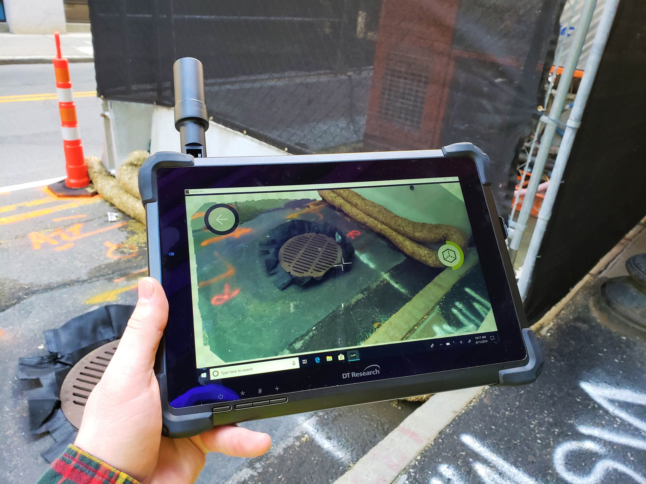
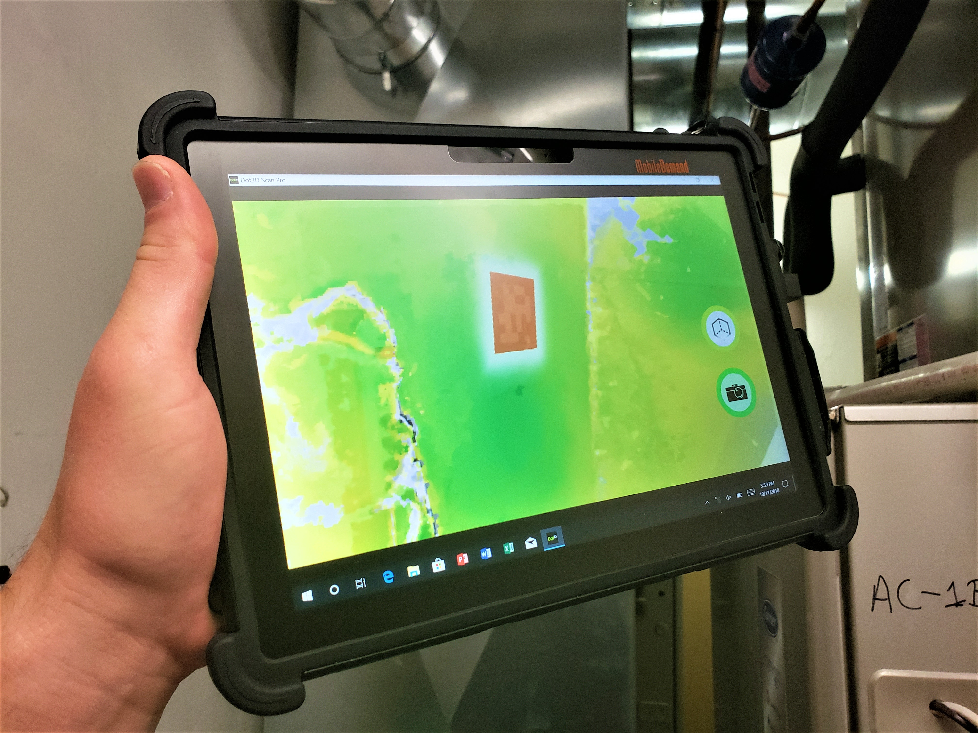
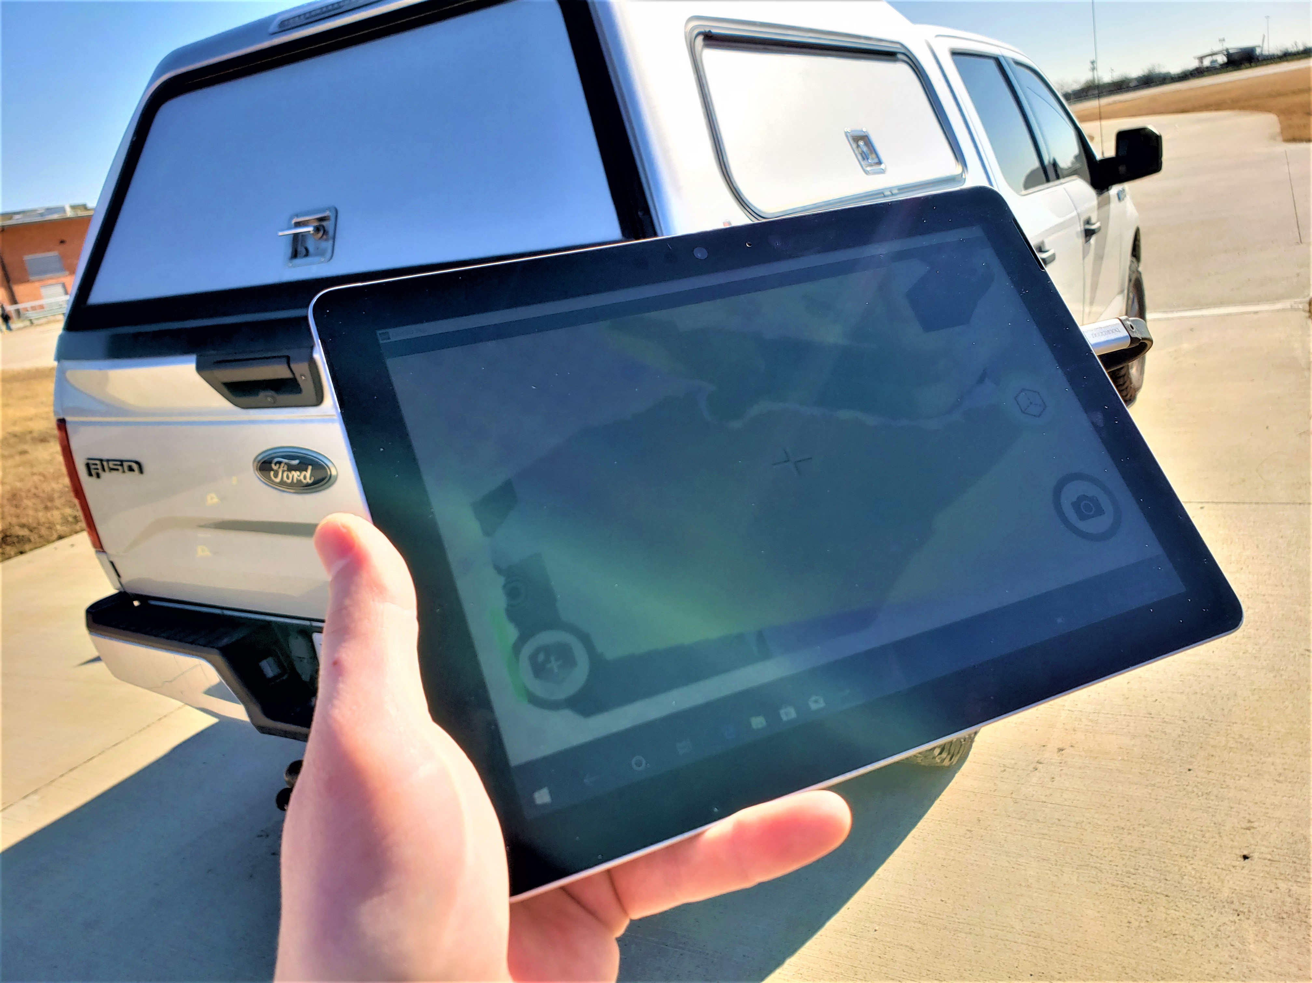
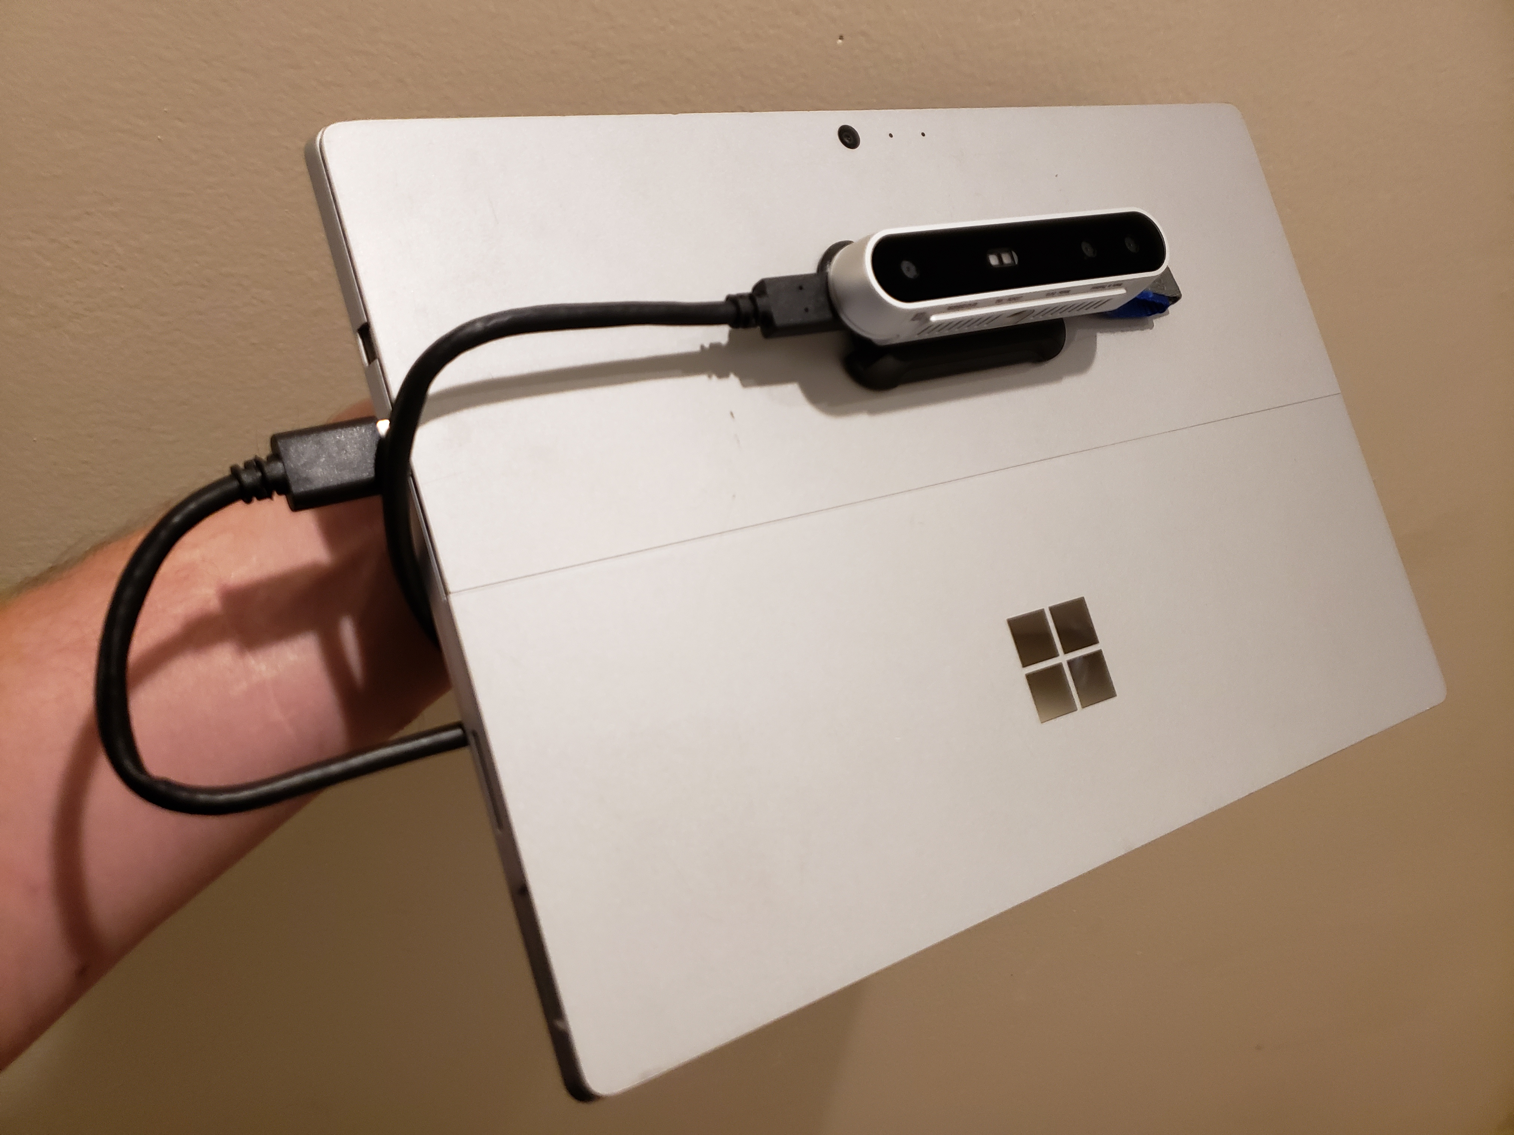
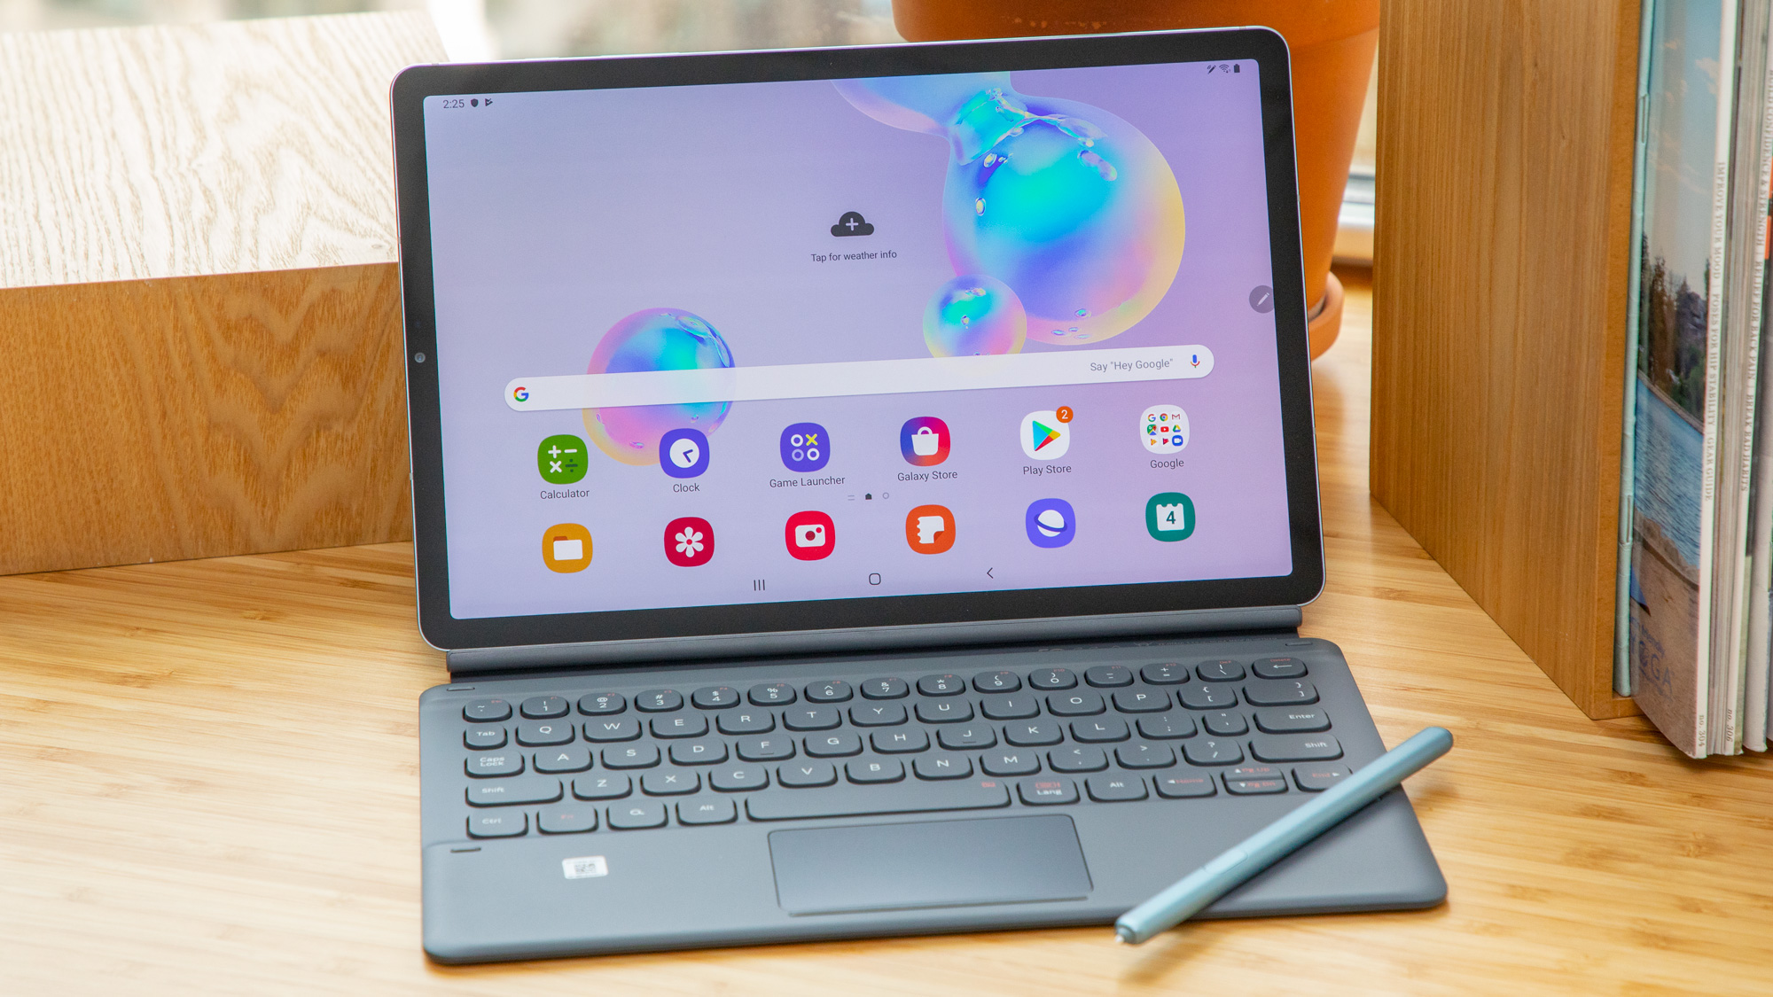
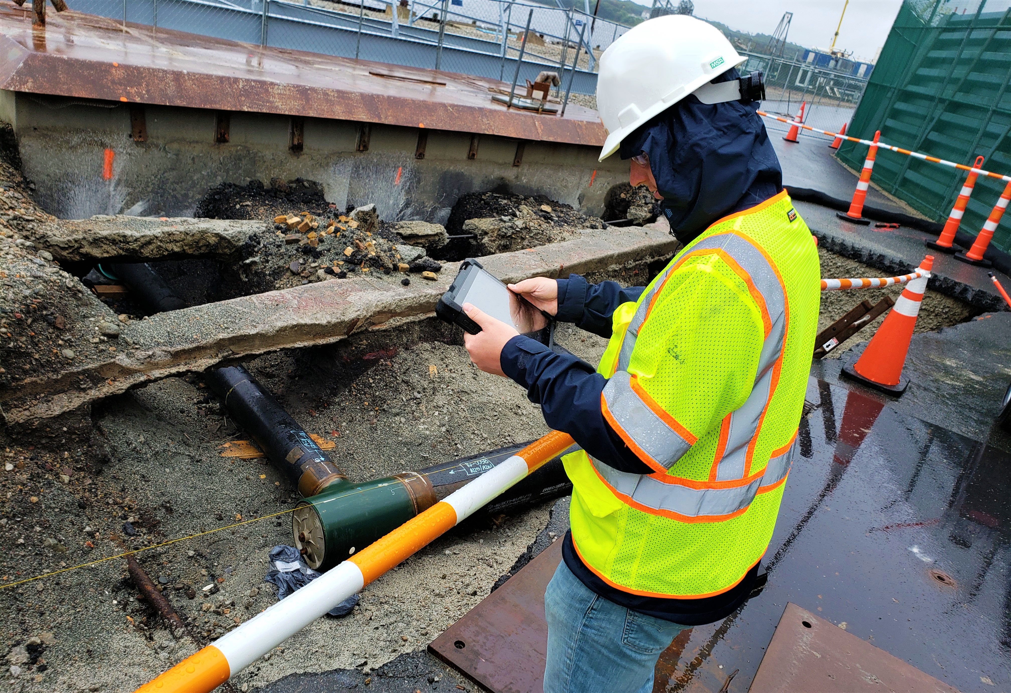
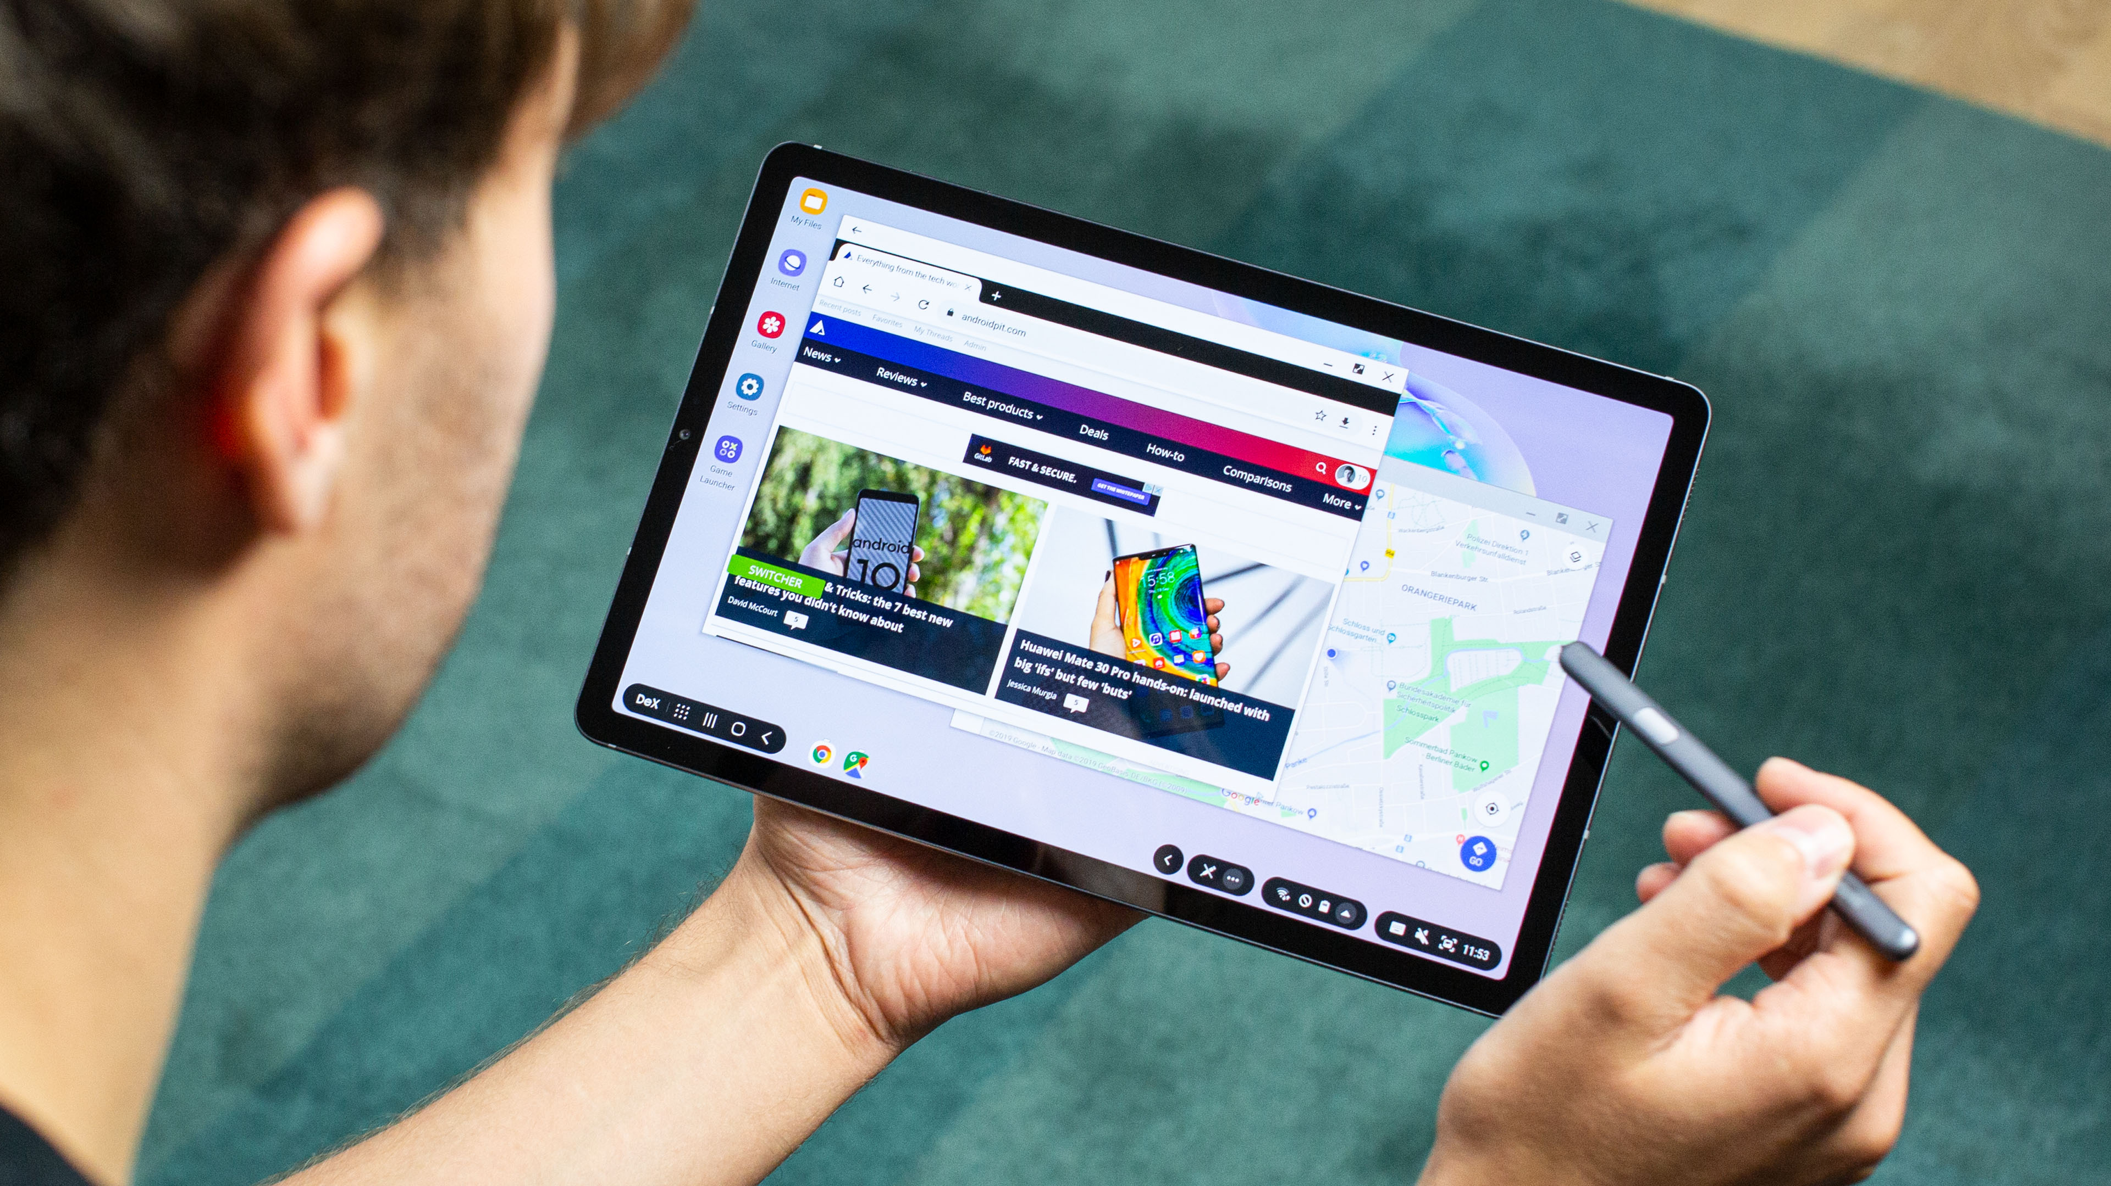
Hardware: Supported Tablets
Rugged Tablets from DT Research, MobileDemand, Zebra, Trimble, & more
Surface Go / Surface Pro
Samsung Galaxy Tab S6, Tab S7, and other tablets/PCs

Slide 6
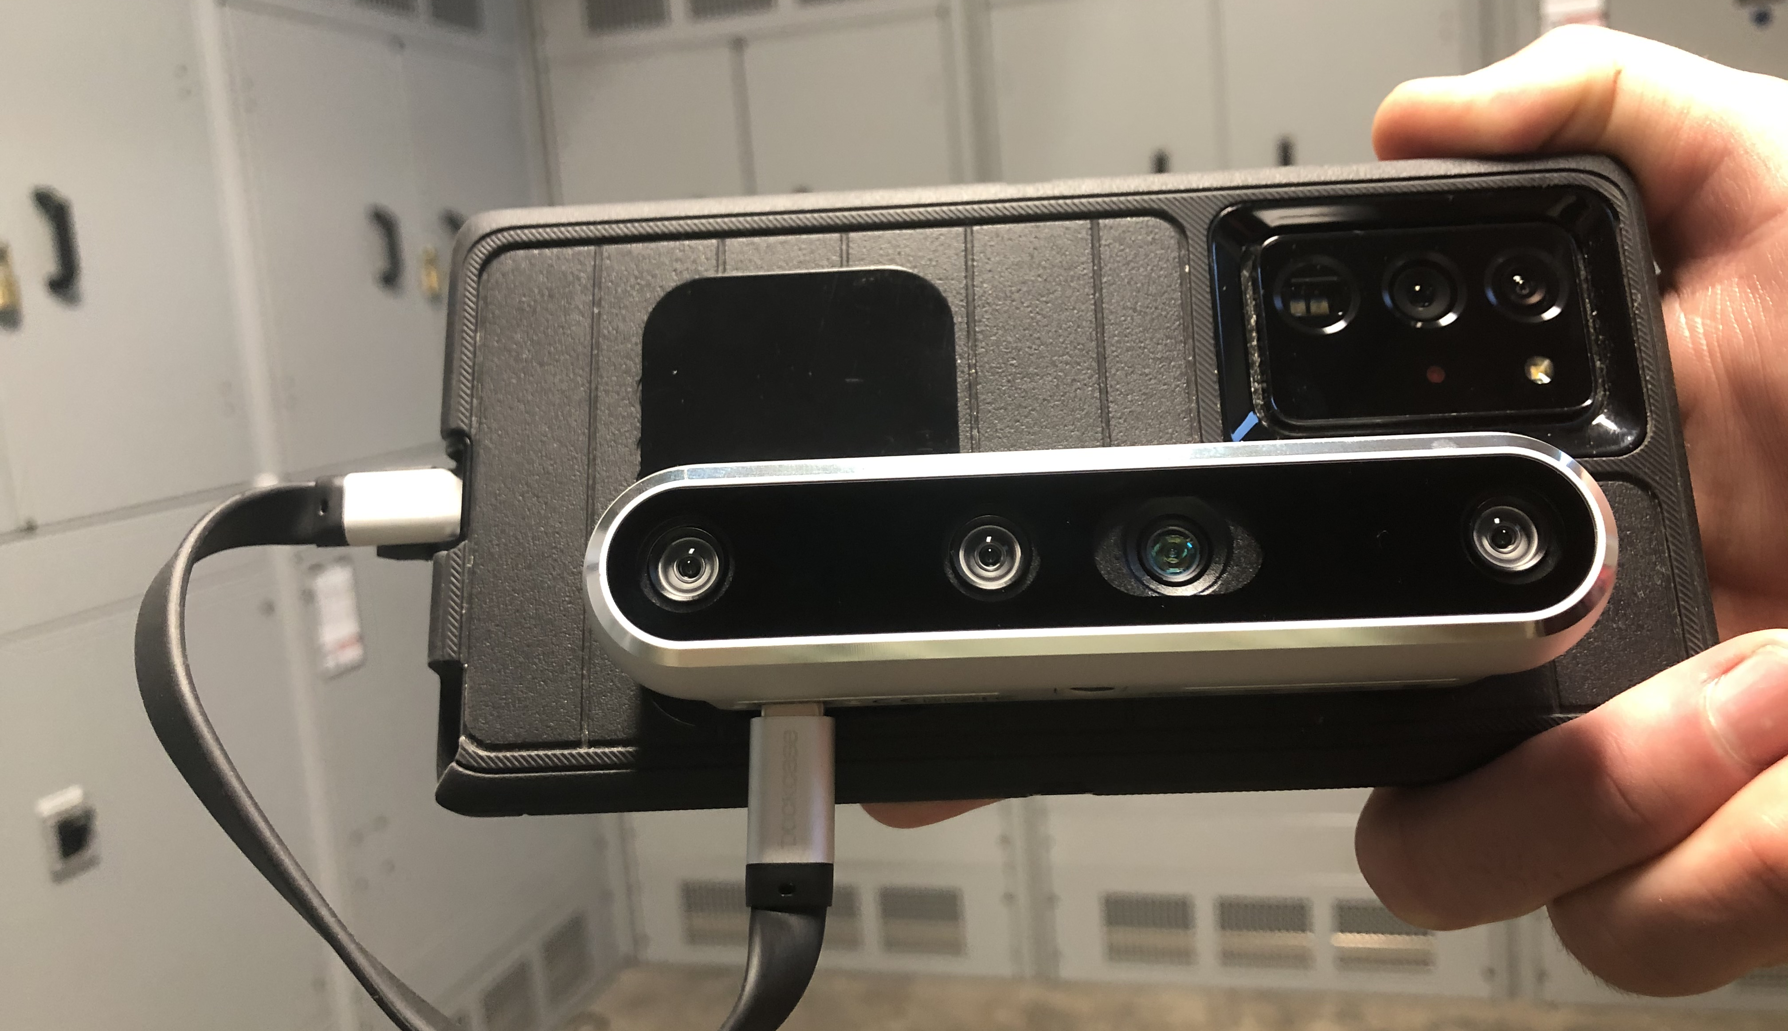
Hardware: Supported Phones
1. Samsung Galaxy S20, S10, & S9
3. Google Pixel 5, 4, & 3 phones
2. Samsung Galaxy Note20, 10, & 9
4. Plus many more Android phones

Slide 7
Minimum Tablet/Phone/PC Specifications
At least one USB 3.0 (or higher) compatible USB port
At least 1 GB of available hard drive / storage space
Internet connection (to activate your Dot3D license)
WINDOWS
Windows 10 or later OS
Intel Pentium Gold 4415Y or comparable
OpenGL 3.3 compatible graphics
At least 4 GB of RAM (ideally 6-8 or more)
ANDROID
Android 7 or later OS
Quad Core CPU (not older than 2017)
OpenGL ES 3.1 compatible graphics
At least 4 GB of RAM (ideally 6-8 or more)
USB 3.0 (or higher) compatible USB cable (not adapter)

Slide 8
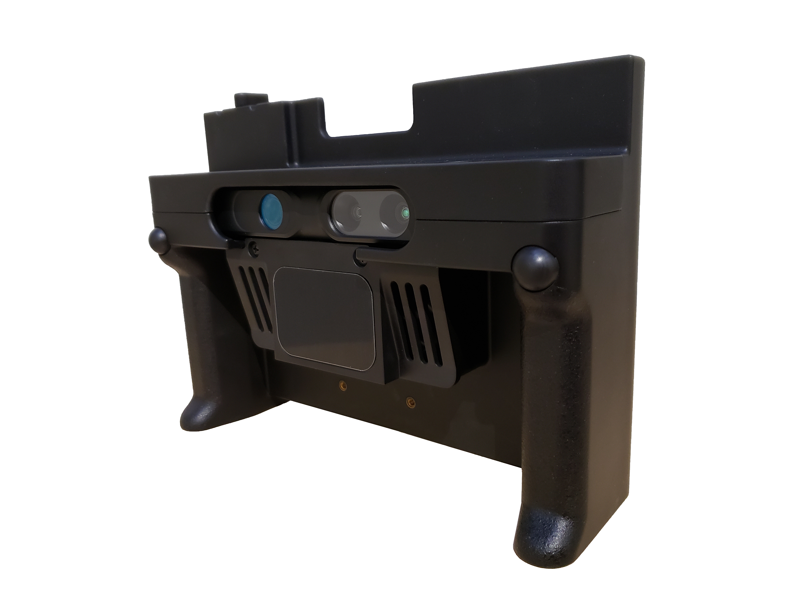
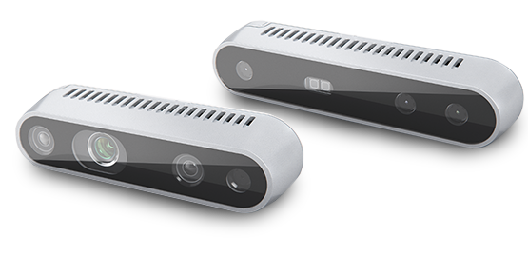
Hardware: Supported Sensors
DPI-10/DPI-10SR Kits
Intel® RealSense™ Kits
DP-Calibrated PrimeSense Carmine 1.08/1.09
D415, D35, D435i, and…

Slide 9
Intel® RealSense™ LiDAR Camera L515

Slide 10
Intel® RealSense™ LiDAR Camera L515
KEY BENEFITS:
0.5-6.0 m (1.5-20 ft) range - Longest range option for indoor scanning when minimal ambient light
Very inherently accurate – comparable to DPI-10 in ideal conditions
Very small and light – 61 x 26 mm, 100 grams
Very affordable - $349 or $495 from DP with magnet/cable kit
RELEVANT DRAWBACKS:
Does not work in direct sunlight - Also sensitive to ambient lighting (window light).
Not ideal for dark surfaces (black/gray/shiny) - Challenging lighting/surfaces can limit the range.
Currently requires a Dot3D Pro license

Slide 11
Intel® RealSense™ Depth Camera D455

Slide 12
Intel® RealSense™ Depth Camera D455
KEY BENEFITS:
0.33-4.2 m (1-14 ft) range – Both longer and shorter range than the DPI-10 / D415 / D435/i
Wide field of view (86°× 57°depth FOV / 90°× 65°RGB sensor FOV) - Most of any supported camera
Daylight capable – Functional even in direct sunlight
Very affordable - $239 or $595 with custom DP-calibration and magnet/cable mounting kit
Improved accuracy over the D415, D35, and D435i
RELEVANT DRAWBACKS:
Less accurate than the L515, DPI-10, and DPI-10SR
Largest and heaviest RealSense camera - 124×26×29 mm
Pink/purple tint can be present in data captured in direct sunlight

Slide 13
Comparing All the Camera Options
Intel specifications comparison page:
www.intelrealsense.com/compare-depth-cameras
DotProduct supported camera list:
www.dotproduct3d.com/knowledgebase
Recent camera rankings blog:
www.dotproduct3d.com/blog/camranks

Slide 14
Today’s Kit

Slide 15
New in Dot3D 4.0 (now 4.0.1)

Slide 16
New in Dot3D 4.0 (now 4.0.1)
Support for the new Intel® RealSense™ LiDAR Camera L515 and Depth Camera D455
Multiple savable measurement capabilities
Scan-time annotations and custom annotation classes
Exportable measurements, annotations, and images
Improved re-localization functionality
New and improved autosave process
All-new user interface, Lat/Long coordinate support, AprilTag ID display option, and more
Various additional feature improvements, performance optimizations, bug fixes, advanced settings, etc.

Slide 17
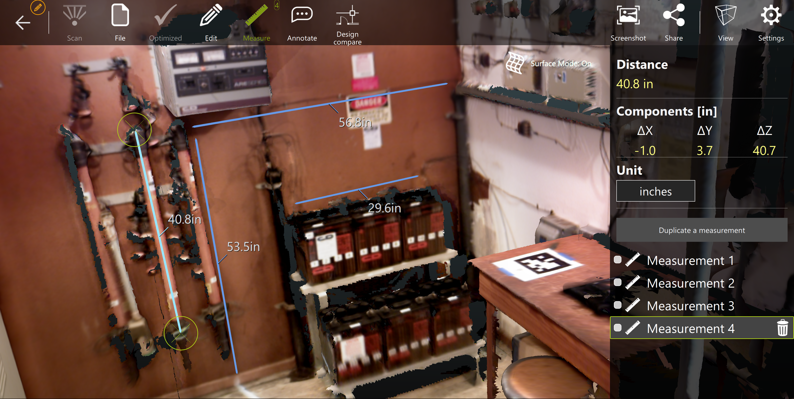
Dot3D 4.0: Multiple Savable Measurements

Slide 18
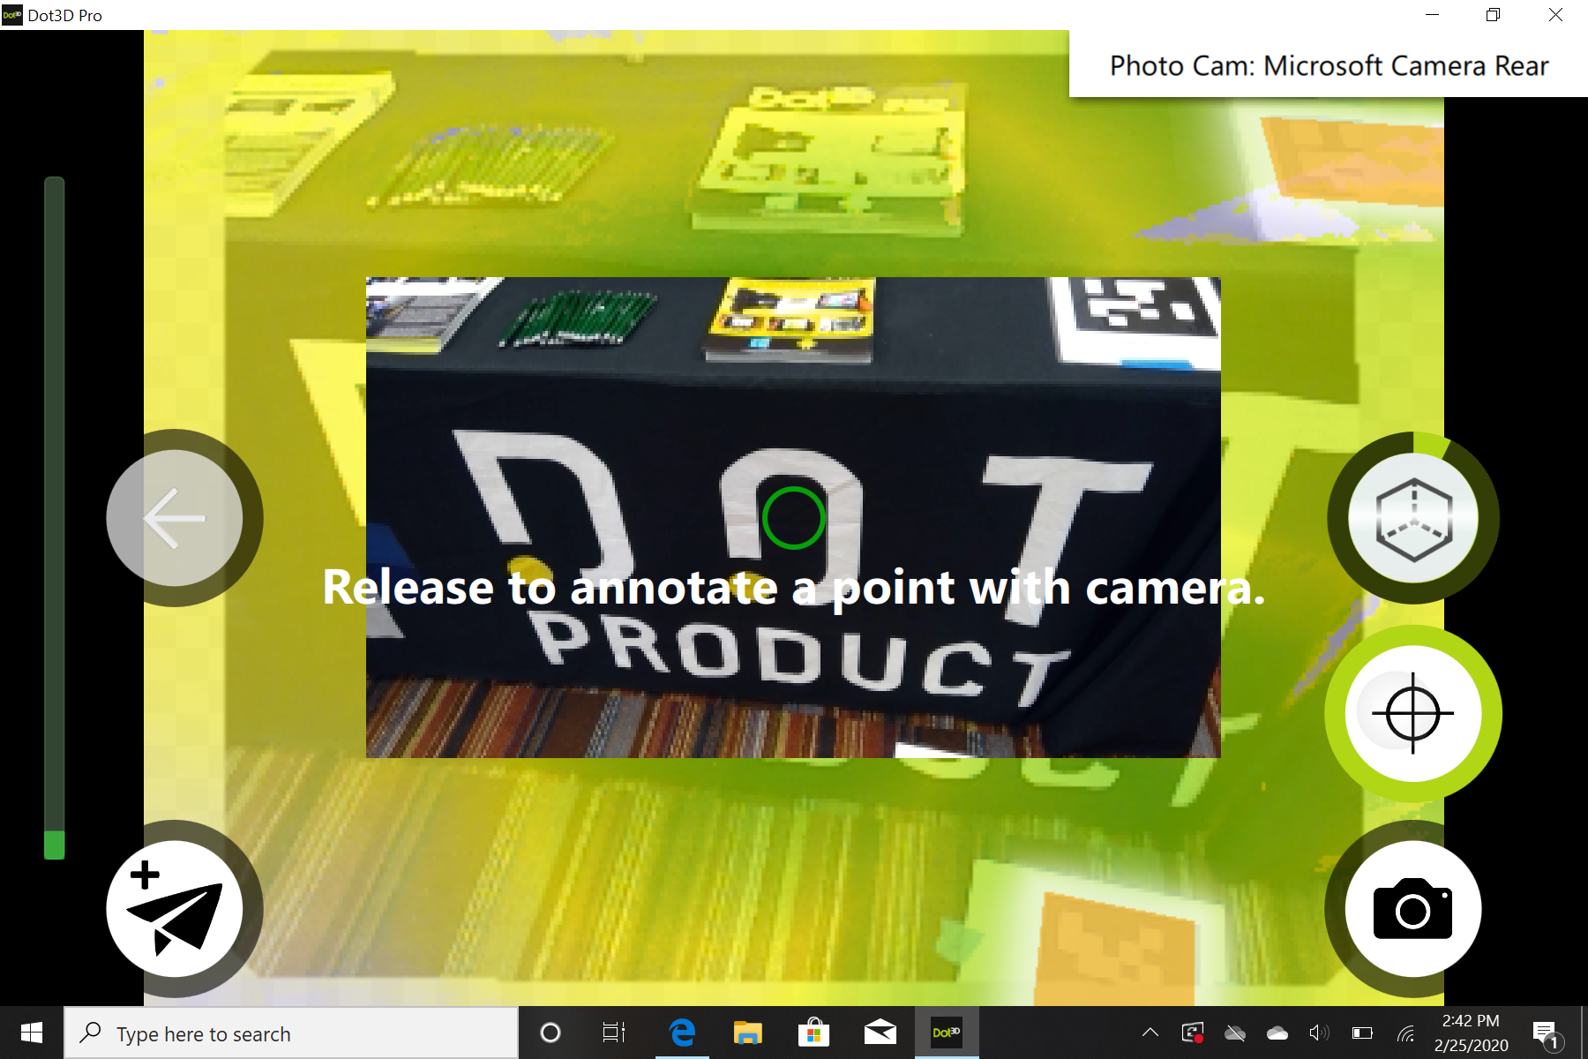
Dot3D 4.0: Live Annotations During Scanning

Slide 19
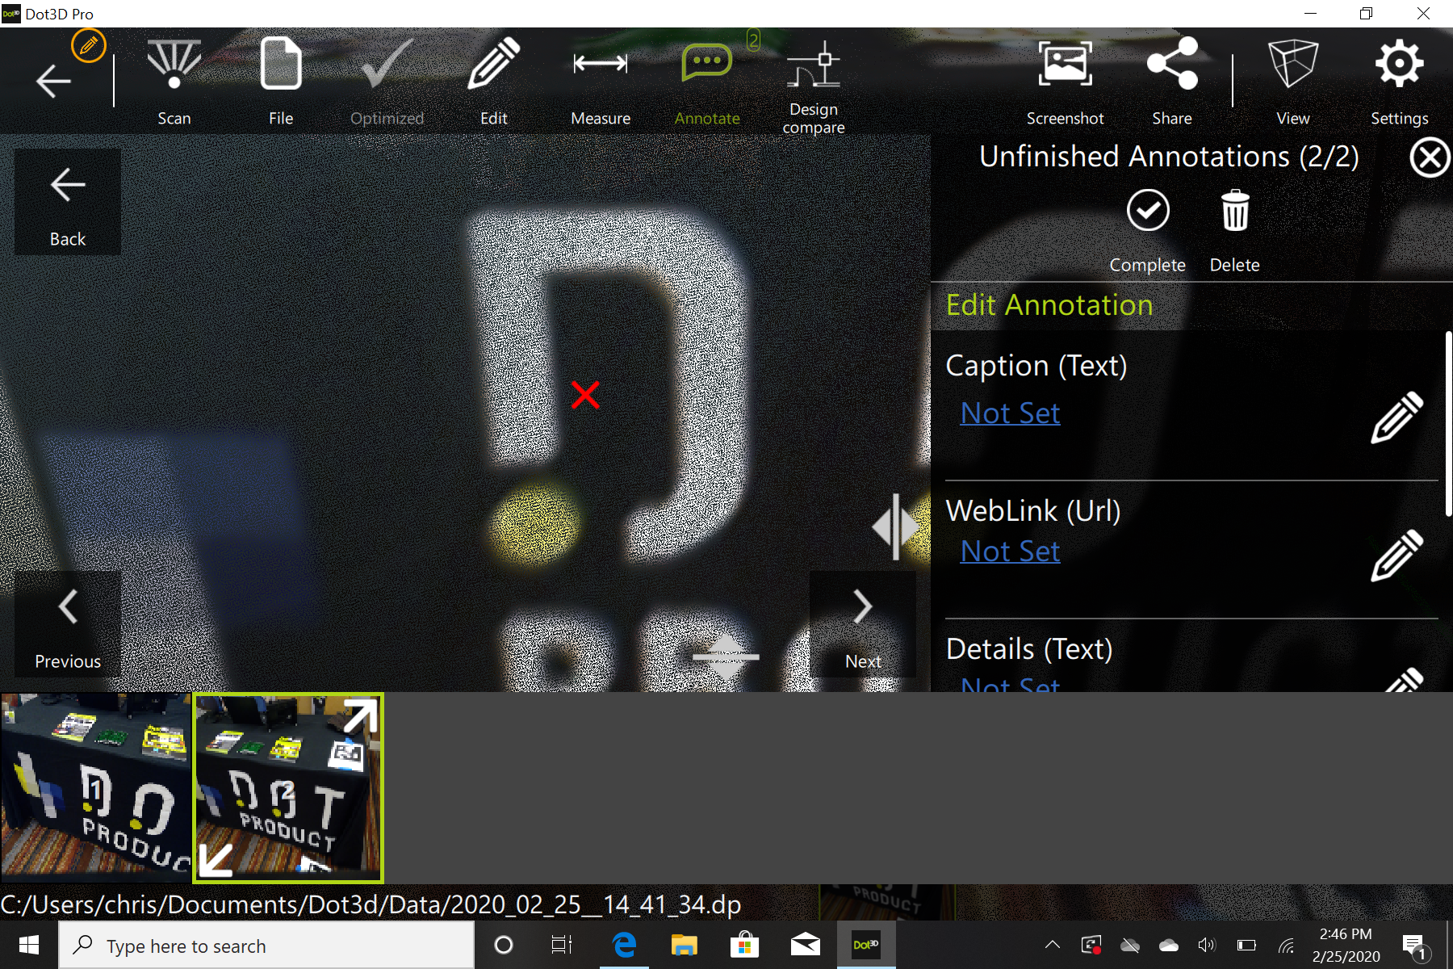
Dot3D 4.0: Live Annotations During Scanning

Slide 20
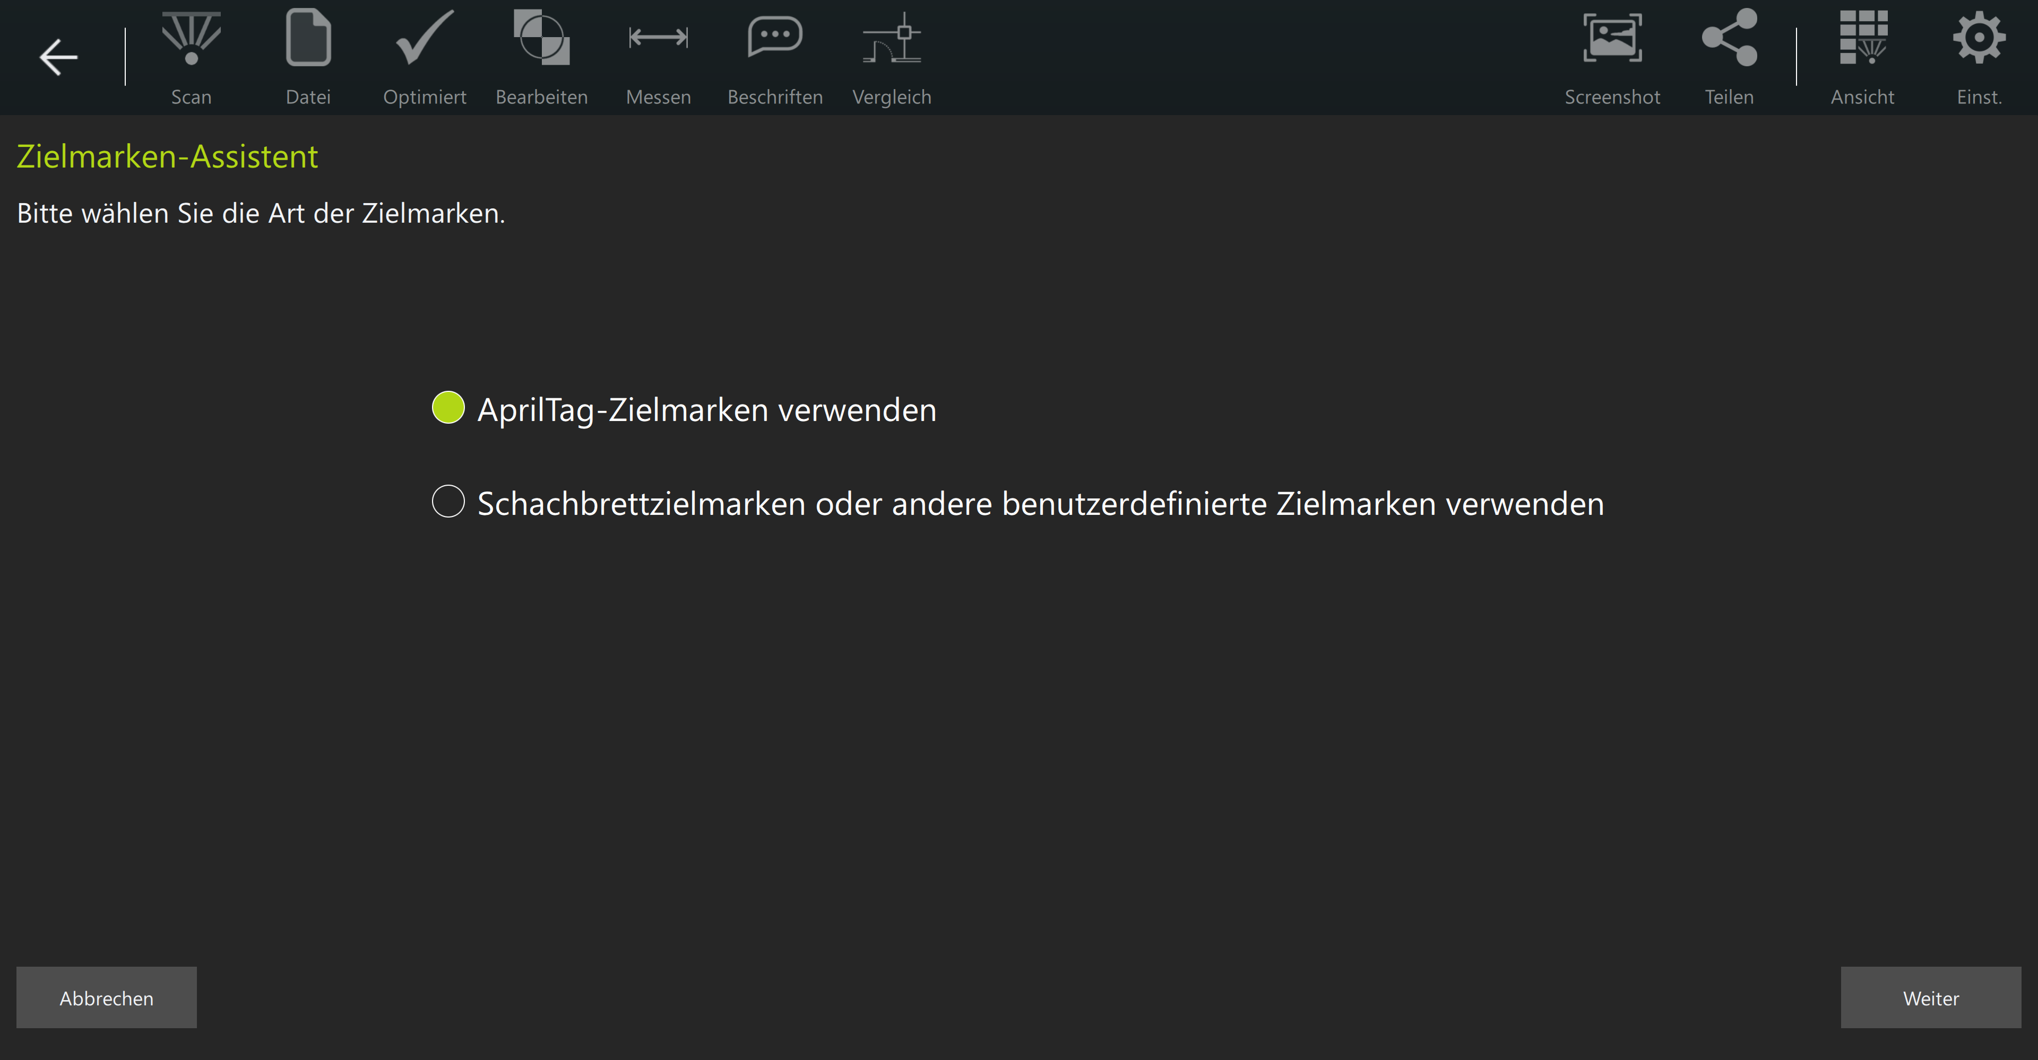
Dot3D 4.0: Foreign Language Support
English, German, French, Spanish, Italian, Mandarin, Japanese

Slide 21
Dot3D 4.0: Re-Localization Improvements

Slide 22
Dot3D 4.0: Re-Localization Improvements

Slide 23
New Autosave and Calibration Processes
All completed scans automatically and immediately saved to the following folders in unoptimized format:
Documents/Dot3d/Autosave on Windows
Internal Storage/Dot3d/Autosave on Android
Each file is also immediately saved to Dot3d/Data by default, and this is the file you normally move forward with for optimization, editing, and save/export
Dot3D now automatically creates a folder for calibration files. Add each calibration file here:
Documents/Dot3d/Calibrations on Windows
Internal Storage/Dot3d/Calibrations on Android

Slide 24
Additional Improvements with 4.0.1
All New User Interface
Clean overhaul and redesign of overall Dot3D UI
Latitude and longitude referencing capabilities
Lat/Long coordinate input for coordinate systems
Lat/Long coordinate input for annotations
Display of Lat/Long annotations on a map (Android only)
Language Options
AprilTags Display Option
See the unique ID of each AprilTag in your scene

Slide 25
LIVE SCANNING

Slide 26
Q & A

